Slide 2
MDNeReading 85 - MDNeReading 85 (mdnkids.com)

Slide 5
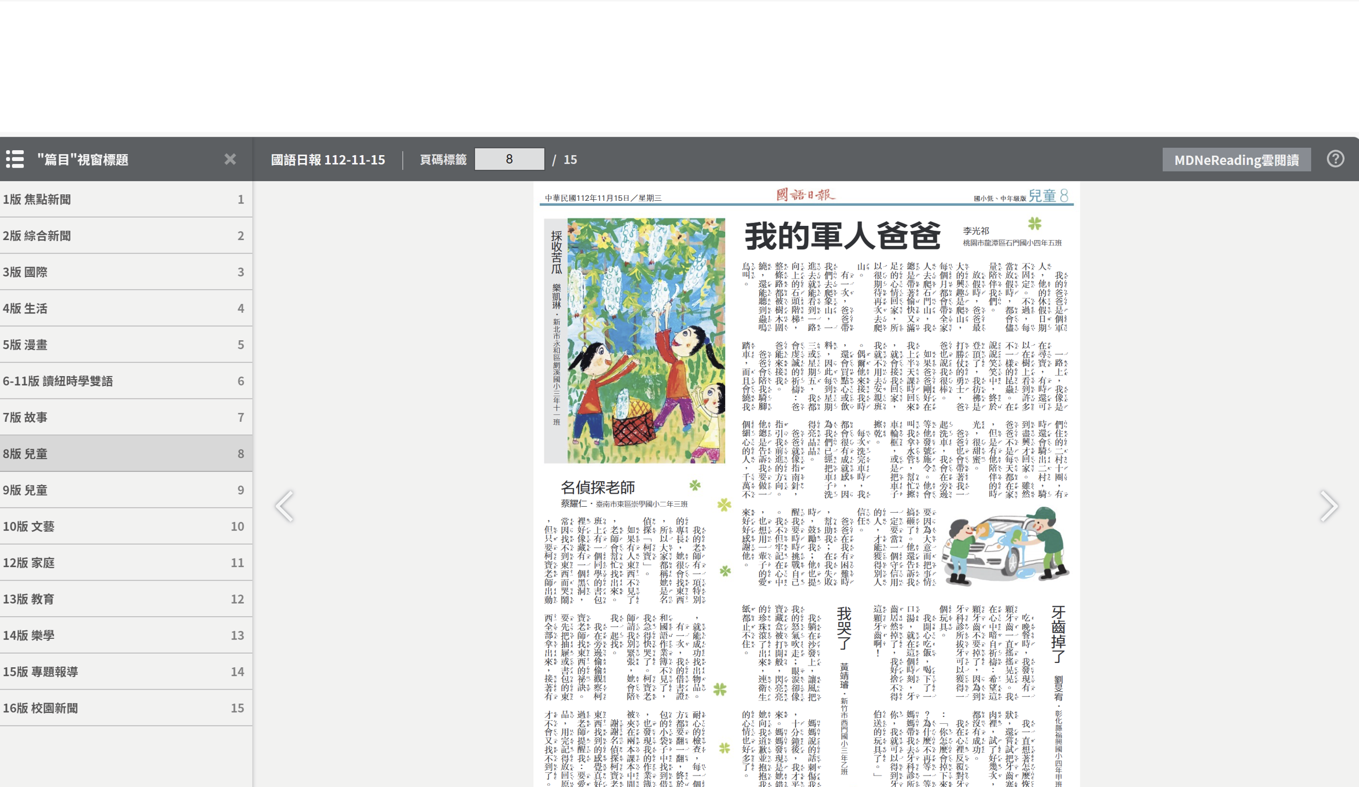

Slide 10
解答篇密碼
12345678

Slide 11
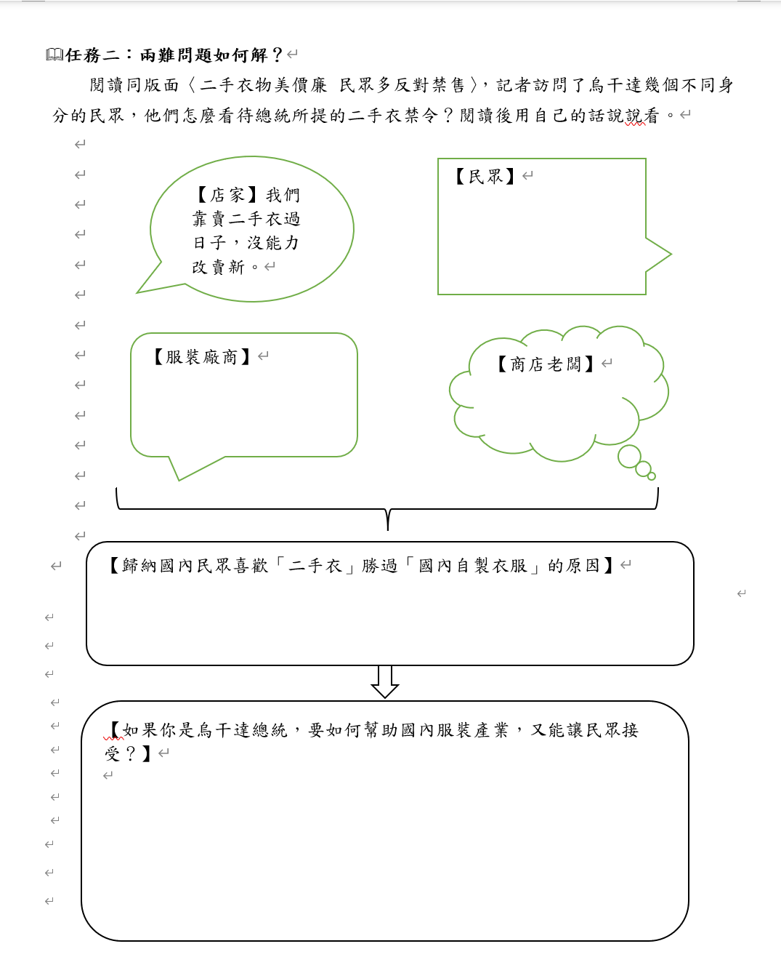

Slide 12
